Slide 1

STELLA OBASANJO HOSPITAL – EDSG MOH
PHASED EXECUTION PROPOSAL – FINANCIAL PLANNING
TANIT MEDICAL ENGINEERING

Slide 2
BRIEF
PHASE 1
OPD CONSTRUCT
EQUIP OPD
PHASE 2
EQUIP DIAG
PHASE 3
IPD COMPLETE
EQUIP COMPLETE
PHASE 4
ADMIN
FURNISH
FURNISH COMPLETE
FURNISH DIAG
MEDICAL GAS
FURNISH OPD
OPERATE OPD
OPERATE DIAG
FULL OPERATION
UTILISE
IPD GROUND FRONT
The purpose of the phased approach:
Adopt a procurement plan that fits the budget
Ensure functionality and service delivery
Focus on income generation
Reduce Operating costs to fit the service delivery
Enable the EDSG to complete the SOH Complex before end Q4 2023
TANIT MEDICAL ENGINEERING

Slide 3
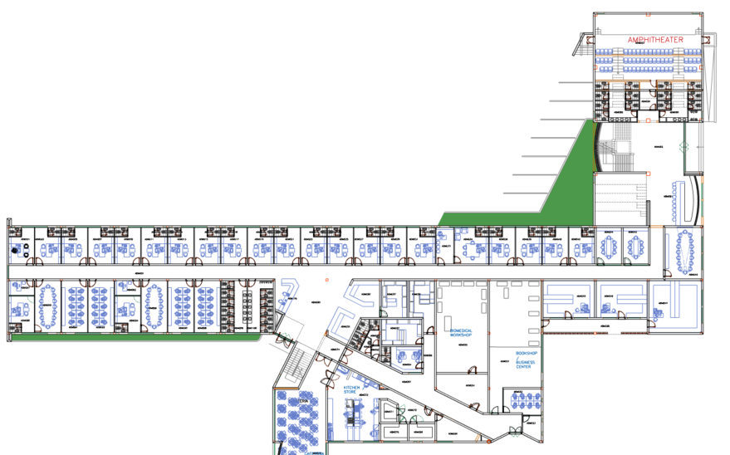
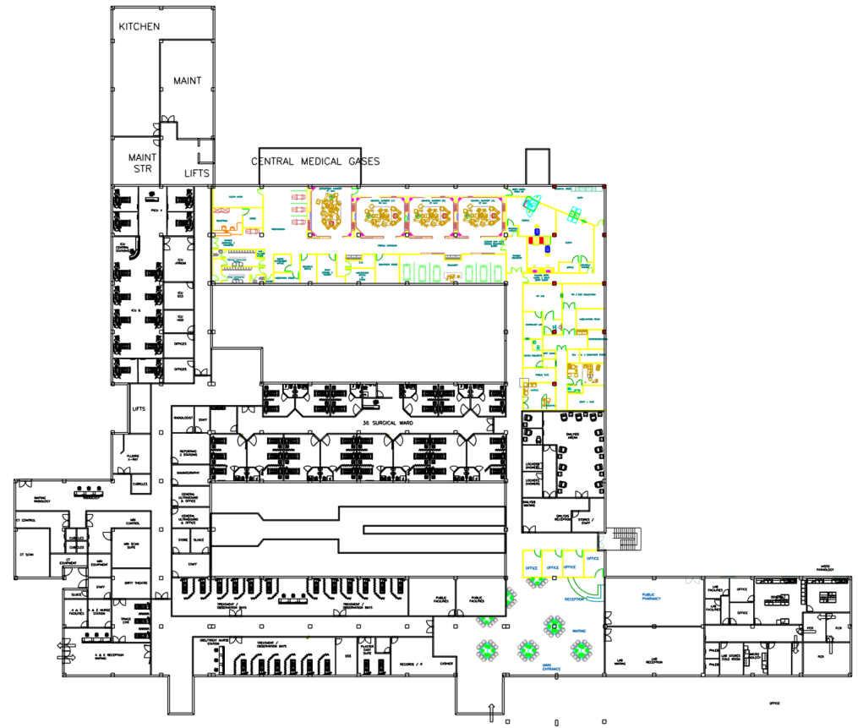
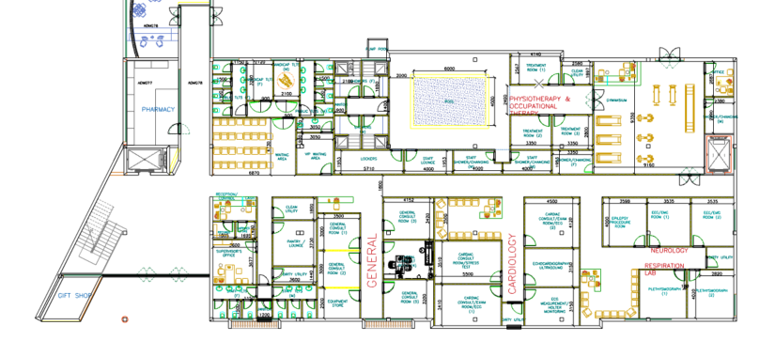
CONSTRUCTION PHASES
3.IPD COMPLETE
4. ADMIN
1.OPD
2.IPD DIAGNOSTICS
TANIT MEDICAL ENGINEERING

Slide 4
PROCUREMENT/CONSTRUCT PHASING
PRIORITIZATION OF SERVICES:
OPD: The Outpatient Department on 2 levels CONSTRUCTION
OPD: The Outpatient Department on 2 levels to be equipped and furnished
IPD phase 1: Entire Ground FRONT section to be concluded
IPD MEDICAL Gases: To coincide with Phased construction in IPD
IPD phase 1: Diagnostics Radiology and Laboratory Equipped and Furnished
IPD phase 2: Complete construction works and Medical Gases
IPD phase 2: Surgical and Medical floors to be equipped and furnished
IPD phase 3: Maternity and IVF, Endoscopy and Dialysis to be equipped and furnished
ADMIN phase 4: Complete Construction
ADMIN phase 4: Furnish
TANIT MEDICAL ENGINEERING

Slide 5
PRIORITY PROCUREMENT
Phase | expense | delivery | Remarks
OPD Equipment | =N= 883,215,900 | Q4 2022 | Part of LOT 1 – Award LOT 1
DIAGNOSTICS - RADIOLOGY | =N= 2,221,752,000 | Q1 2023 | LOT 2 – Award LOT 2
DIAGNOSTICS - LAB | =N= 1,090,041,596 | Q1 2023 | Excluding IVF – Award LOT 6
OPD and Diagnostics Furniture | =N= 1,000,000,000 | Q4 2022 | ESTIMATED Part of LOT 5 – TENDER AND AWARD LOT 5 (NOT YET TENDERED)
MEDICAL GASES | =N= 655,544,669 | Q1 2023 | Award – LOT 3
TOTAL DISBURSEMENT | =N= 5,850,554,165 | Q2 2023 | EXCLUDING VARIATION DUE TO FX FLUCTUATION AND DUTIES
TANIT MEDICAL ENGINEERING

